Slide 1
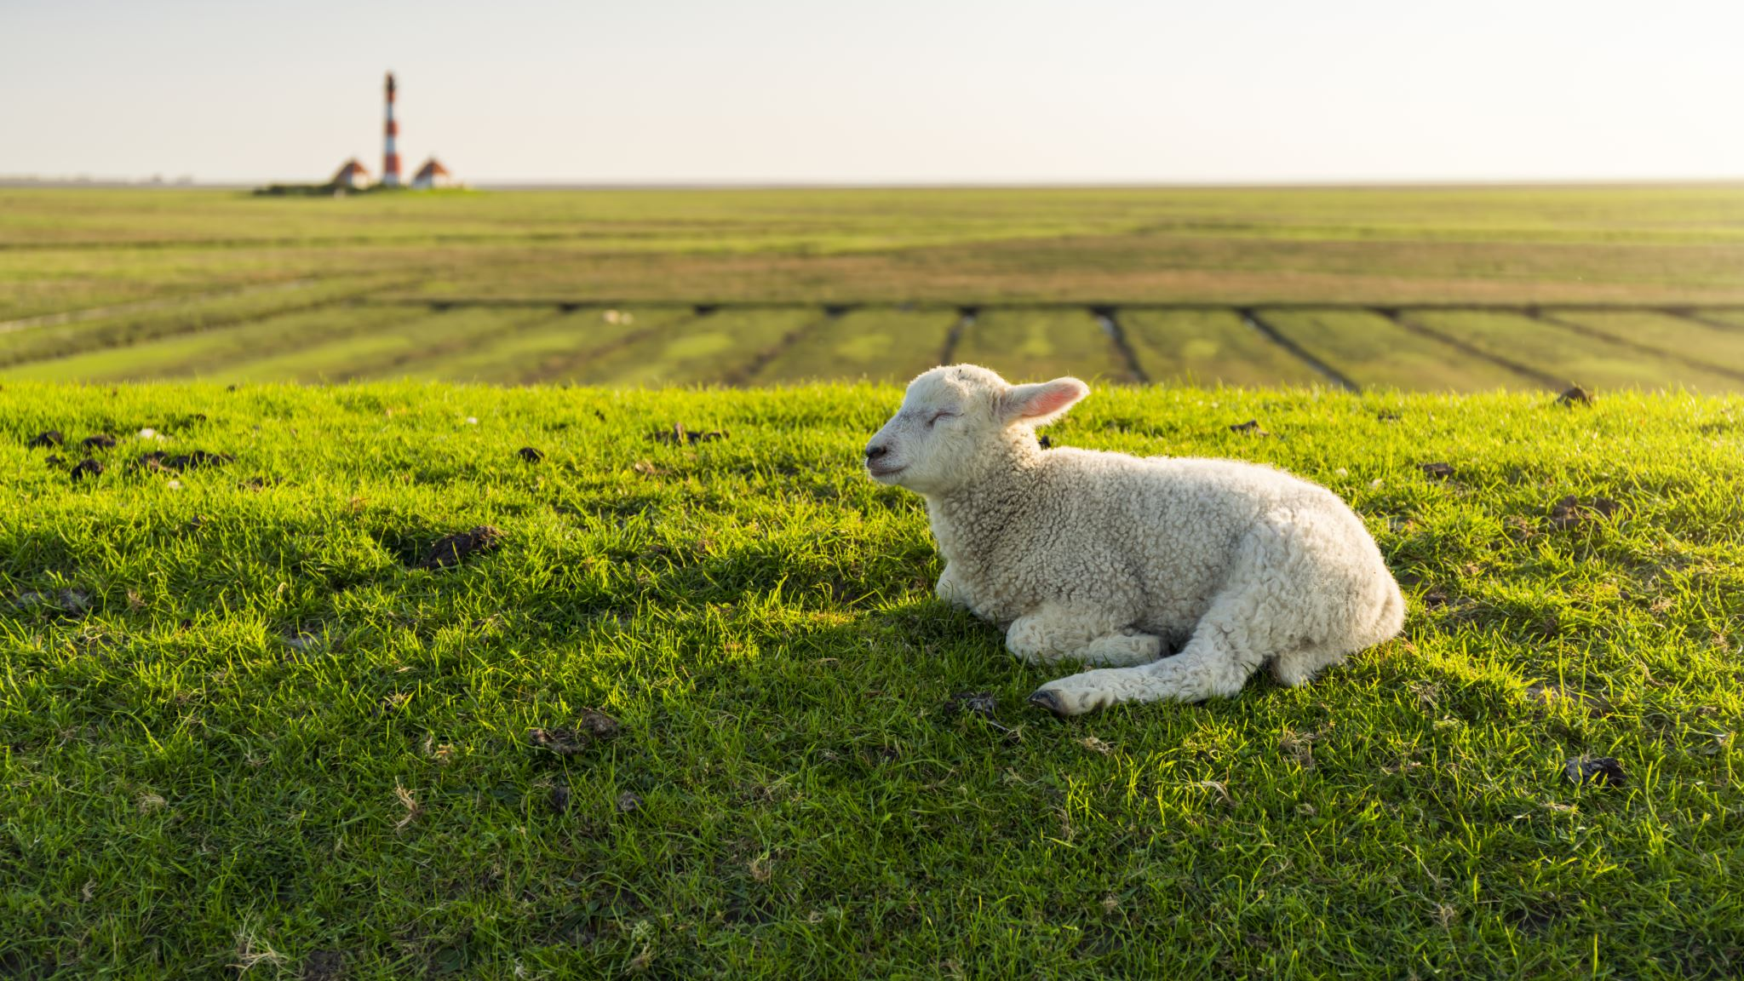
NPK MAPPING
Debabrata Mitra

Slide 2
2
1
5
3
Unveiling
The Thoughts
HIGHLIGHTED FEATURES
Main Agricultural
ProblemS in INDIA
Idea
Solution

Slide 3
1
2
3
4
Unveiling
The Thoughts
Main Agricultural
ProblemS in INDIA
How it
works
Workflow
Solution
& Idea

Slide 4
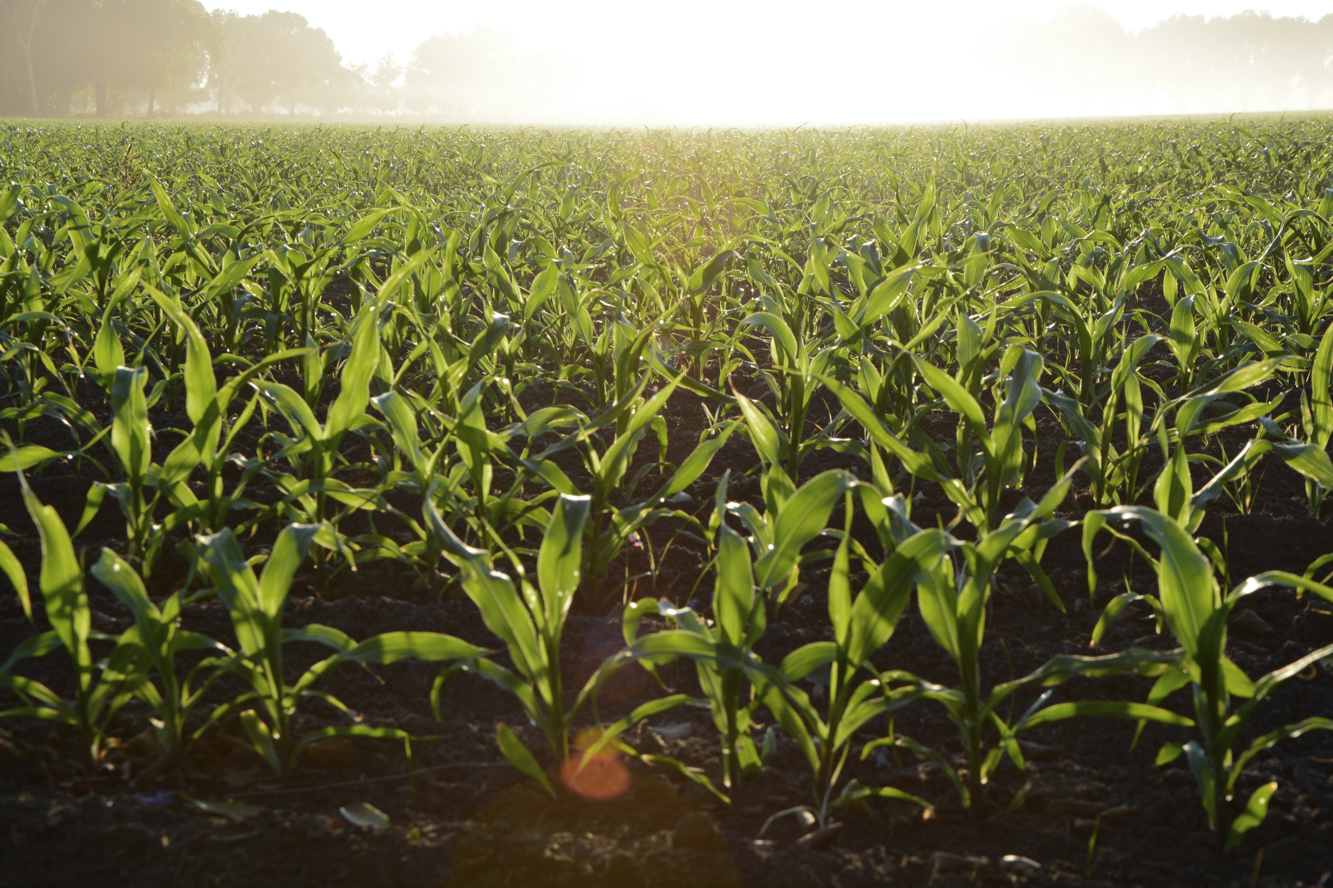
Technology is changing farming in India, but there are challenges affecting productivity and sustainability:
1. Small Farms: Many farmers have small plots, making farming inefficient. This makes it hard for them to use modern methods and technologies, leading to lower productivity.
2. Old Farming Methods: A lot of Indian farmers still use traditional methods due to limited information and resistance to change. This lack of awareness hampers the use of better farming practices.
3. Soil Issues: Wrong land use, too many chemicals, and poor soil conservation harm the soil. This lowers fertility, increases vulnerability to pests and diseases, and reduces productivity.
4. Tech and Research Access: Farmers struggle to access agricultural services, modern technologies, and scientific research. They need better knowledge sharing, training, and affordable technology tailored to their needs.
Main
Agricultural Problems

Slide 5
Solutions
Firstly, it is crucial to understand the levels of nitrogen (N), phosphorus (P), and potassium (K) in the field. Secondly, accurate knowledge of nutrient content enables farmers to determine the appropriate type and intensity of fertilizer required for optimal crop growth. Finally, this information enhances efficiency in agricultural practices, ensuring that crop yields are maximized while minimizing soil and water pollution.
Ideology
Detecting The Nutrients Level Of The Specific Field Location (GPS Co-ordinate)
Analyzing The Data & Mapping Nutrient Level In Google Map
Suggesting The Fertilizer Type, Intensity & Next Planted Crops through App
Smart Spraying system will have its GPS & and will connect to the specific app by WIFI
Smart Spraying system to Spray the specific fertilizer in a specific amount in a particular position.
This system can also be connected to the Drone Spraying and mission planning application. ( E.G- Qgc)

Slide 6

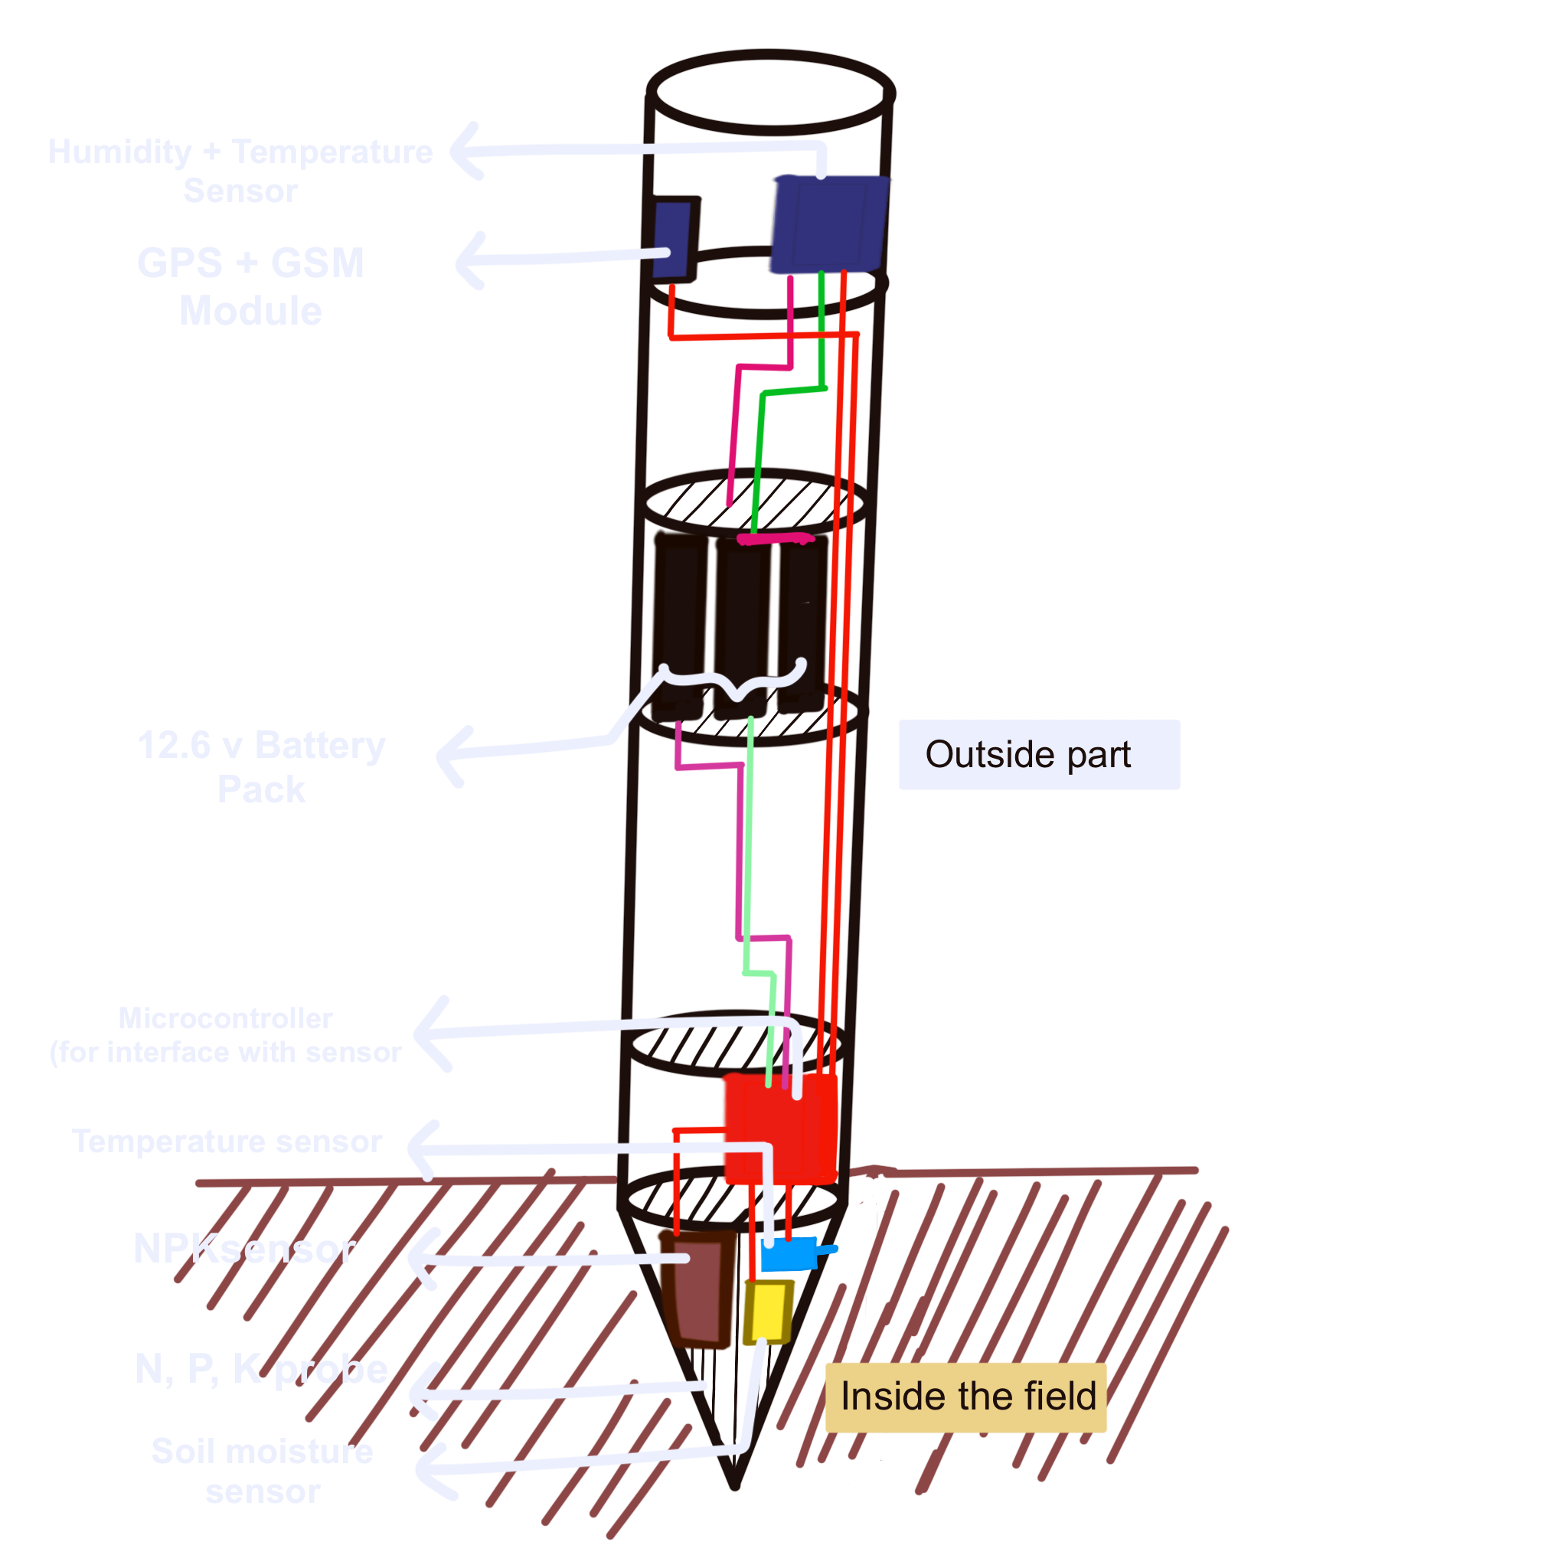
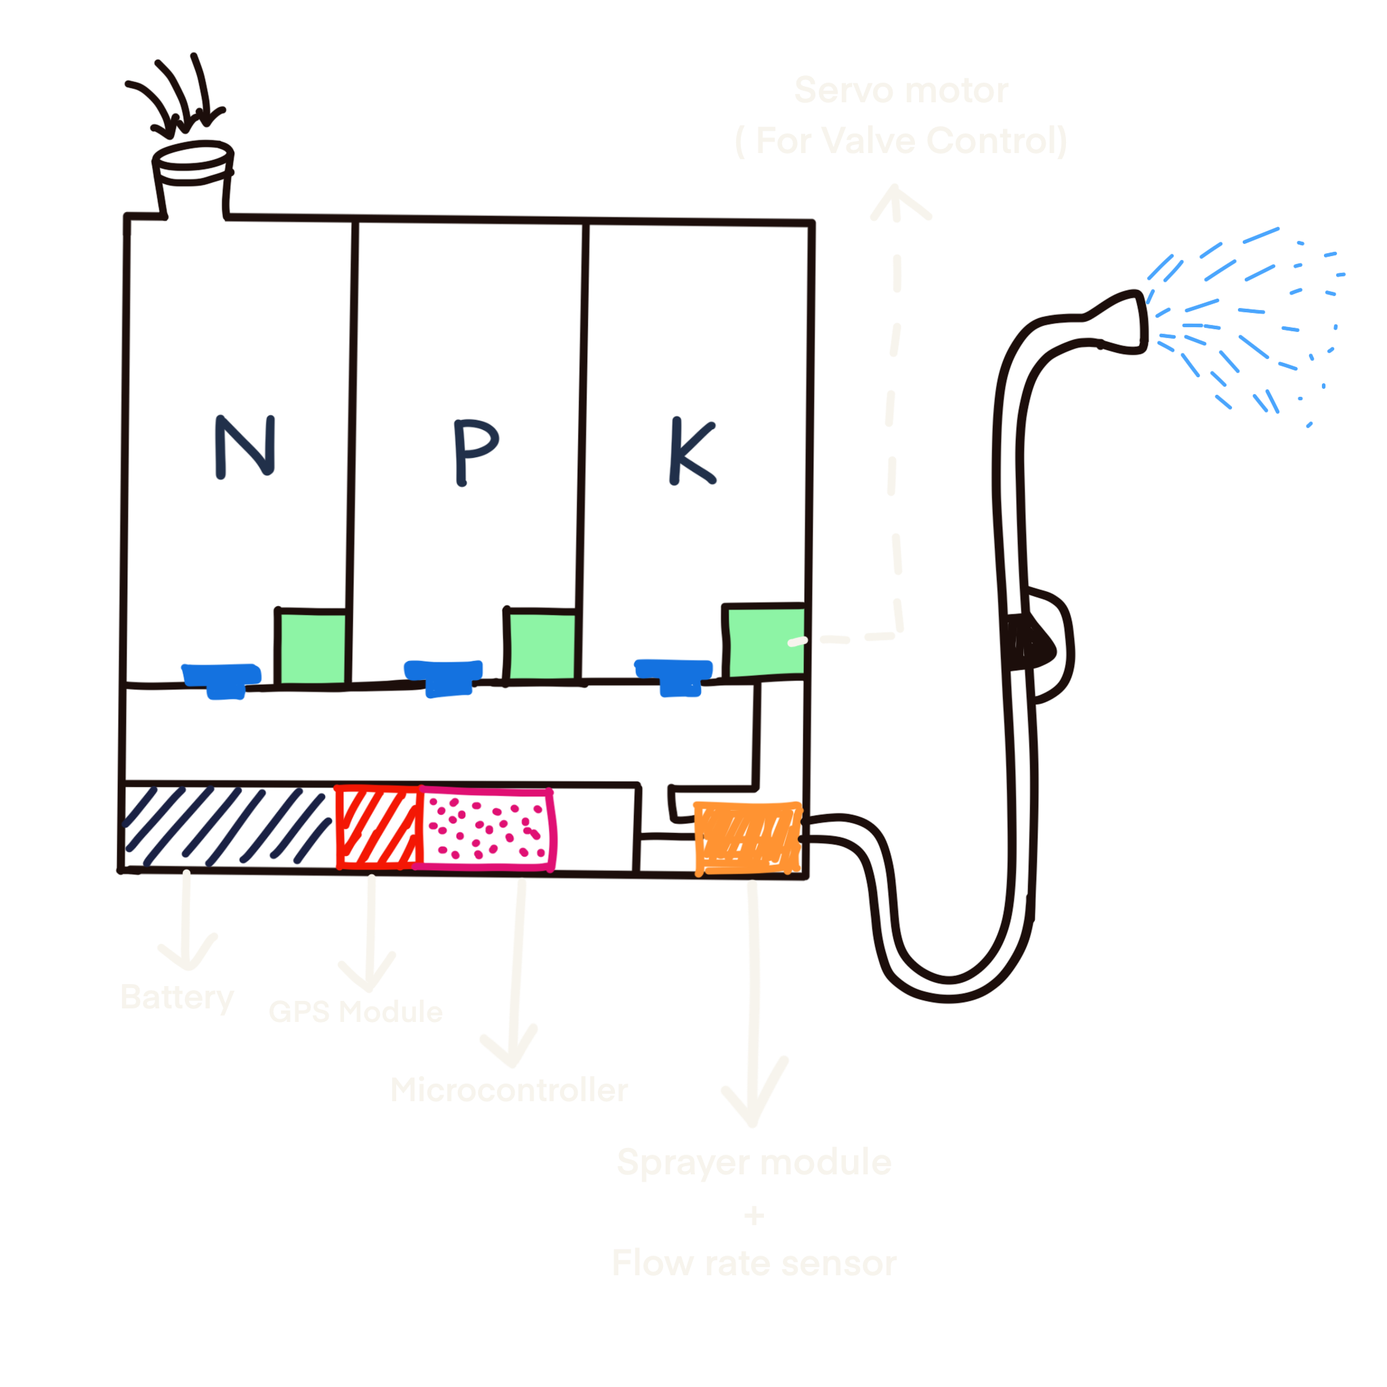

HOW
IT
WORKS
Cloud
GPS Co-ordinate
[ NPK Detector ]
[ Smart Sprayer ]
[ Drone Sprayer ]

Slide 7
GPS
Cloud
GPS+GSM [module transmits the data through the 4G internet]
CLOUD STORE [the data and pass to the app]
SENSOR detects the parameter value
ESP32
Microcontroller interface the sensor value
Cloud se
Cloud
Servo valve
ESP32 [microcontroller for interface flow-rate sensor, GPS co-ordinate, control motor driver, and servo valve]
APP
Cloud
Cloud
MOTOR DRIVER
[for controlling the fertilizer selection .]
MOTOR
[for spraying.]
Cloud
Cloud [
Cloud
Drone spraying system
Flow rate sensor
[detect the flow rates from motor
Nozzle and feedback to the esp32.]
GPS
[find the current location of the sprayer and send it to the app by esp32.]
WORKFLOW
Thank You

